Slide 1
CHAPTER 14
Sexual Aggression and Coercion

Slide 2
Child Abuse, Pedophilia, and Age of Consent
Minor: person who is under certain age.
Age of consent: legal age at which a person can consent to sexual contact with an adult.
Pedophilia or pedophilic disorder: intense and recurrent sexual attraction towards children by someone who is an adult:
  Pedophile: person with pedophilia.
Hebephilia: attraction and arousal in adults focused on pubescent adolescents to post-pubescent mid-adolescents:
  Ages 11-14
Ephebophilia: attraction and arousal in adults focused on mid-to-late adolescents:
  Ages 15-19
  Includes attractions to those who are of legal age to consent.

Slide 3
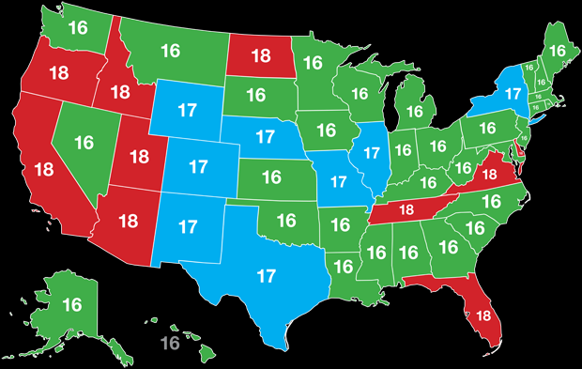
Child Abuse, Pedophilia, and Age of Consent
Minor attracted person / people (MAP): people with attractions to minors, includes those with pedophilia and hebephilia.
Child sexual abuse (CSA): sexual contact by a person over the age of consent with a person under the legal age of consent:
  Can include minors who engage in sexual behavior with other minors.
Intrafamilial CSA: occurs between adults and minors where the adults are in parental or guardian role.
Incest: sexual contact involving close biological relatives.
Sexual offense: any illegal sexual activity.
  Includes CSA, rape, and any illegal activity involving pornography.

Slide 4
Prevalence of Child Sexual Abuse
Estimates of male victims of CSA are underreported due to societal prejudices about gender roles.
Only a tiny fraction of all cases of CSA are ever reported to child protective services.
Research studies vary widely regarding estimated prevalence of CSA.
In a 2013 study, The prevalence of child sexual abuse was 10.14% (24.8% in men, and 75.2% in women).
Pérez-Fuentes, G., Olfson, M., Villegas, L., Morcillo, C., Wang, S., & Blanco, C. (2013). Prevalence and correlates of child sexual abuse: a national study. Comprehensive psychiatry, 54(1), 16–27. https://doi.org/10.1016/j.comppsych.2012.05.010

Slide 5

Perpetrators of Child Sexual Abuse
Substantial portion of the perpetrators of CSA are themselves juveniles.
In most extrafamilial abuse, preparator is known to the child.
Intrafamilial abusers are less likely to be reported to the authorities.

Slide 6
Pedophilia and CSA
Intra- and extrafamilial abusers also include individuals with adult sexual orientation.
Risk factors for perpetrating CSA:
  Drugs
  Alcohol abuse
  History of having been abused oneself
Having a pedophilic arousal pattern does not mean that a person will become a sex offender.
Pedophilic orientation may be to children of the same-sex, other-sex (most common), or both.
Arousal pattern for those identified as having pedophilia:
  Greatest relative arousal was to children
  Less to adolescents
  Least to adults

Slide 7
Research Focus
Cantor, Kabani, Christensen, Zipursky, Barbaree, Dickey, Blanchard, 2008; Ponseti, Granert, Jansen, Wolff, Beier, Neutze, Bosinski, 2011:
  Compared with sexual offenders who offended against adults or committed nonsexual crimes, CSA offenders had:
    Reduced white matter in the temporal and parietal lobes of the brain.
    Phallometric differences and neurological differences in brain response.

Slide 8
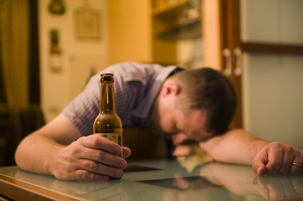
Potential Effects of CSA
Adult sexual dysfunction
Heightened susceptibility to depression
Problems with self-esteem
A doubling of suicide risk
A 40% increase of marrying a person with alcoholism
A 40-50% increase in problems with current marriage
Risk of eating disorders
On children while they are still children:
  Studies showed little lasting negative effects when violent CSA was removed from analysis.
  Trauma is more likely when more coercion is used.

Slide 9
Prevention Efforts
Teaching self-protection skills to children.
Harsh punishments of offenders.
Teaching children to identify good touch / bad touch.
Encouraging children to identify and resist inappropriate touching.
Addressing individuals with pedophilic arousal patterns prior to their engaging in sexual contact with minors.
Mandated reporters: people who are required to report to child protective services if a minor is being abused:
  May also be required to report suspected abuse.
  Tarasoff duties:
    To warn the potential victim or the guardian.
    Protect by notifying authorities.

Slide 10
Investigations, Cover Ups, and False Memories
Criminal investigation of CSA is initiated with a report to child protective services who notify the police.
Damages may be sought from:
  Perpetrators of CSA.
  Institutions whose officials have taken actions to conceal allegations of CSA.
False accusations of CSA may be due to false recollections of abuse.

Slide 11
Research Focus
Loftus & Ketcham, 1996; Otgaar, Horselenberg, van Kampen, & Lalleman, 2011:
  False memory syndrome: believed-in but untrue recollections of earlier events:
    Developed under suggestive memory techniques such as guided imagery and hypnosis.
    False but vivid memories can be created in adults of events that are known to have not occurred.
    Can be about sexual abuse or innocuous events.

Slide 12
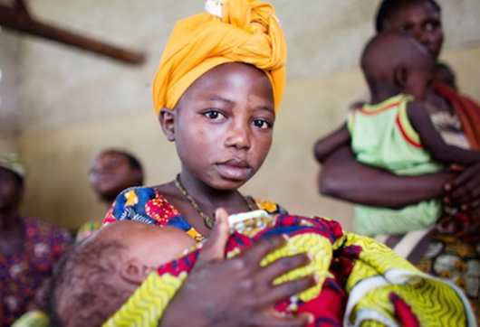
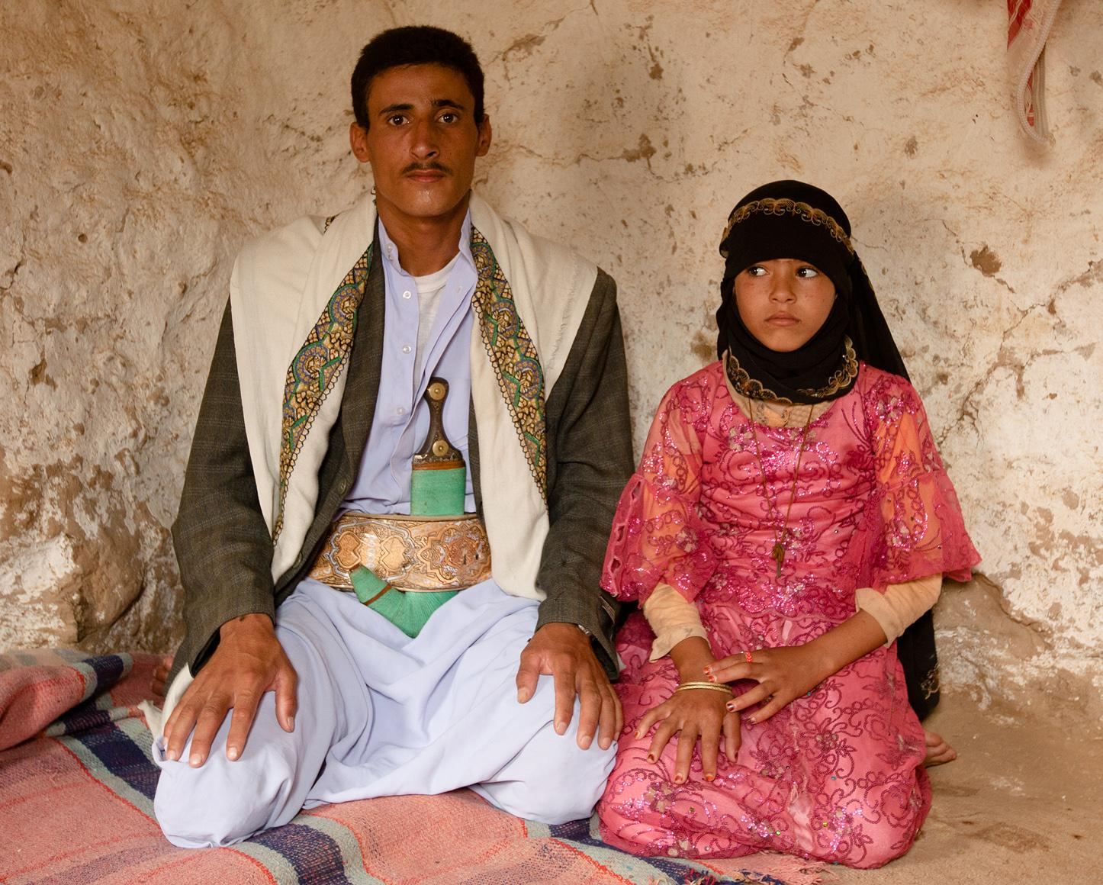
Issues around Adult-Minor Sex
Has different contexts in other cultures and historical eras.
Views vary regarding:
  Capacity to consent
  Right of minors to autonomy
  Ages of consent vary particularly with older adolescents

Slide 13
Rape and Sexual Assault
Rape: A forcible sexual assault involving penetration or attempted penetration.
Criminal sexual assault:
  Coercive physical sexual violence
  Not reported as rape
Acquaintance rape or date rape: assault which may use force or the threat of force by a known perpetrator.
Cultural attitudes affect the reporting and prosecution of sexual assault.

Slide 14

Rape Myths
Attitudes of blaming the victim for the assault:
  Assumption that rape is somehow invited or deserved.
  Women who are sexually active or promiscuous invite rape.
  Dressing a certain way or flirting invites an assault.
  Initiating or engaging in consensual sexual behavior means that consent cannot be withdrawn later.

Slide 15
Rape Laws
Rape shield laws:
  Limit the introduction of evidence about a victim’s prior sexual history.
  Limit other irrelevant information:
    The way a victim dressed.
    Information about prior consensual sex with the accused perpetrator.
Extend some measure of confidentiality to an alleged victim in a criminal case.
Eliminate marital rape exemption.

Slide 16
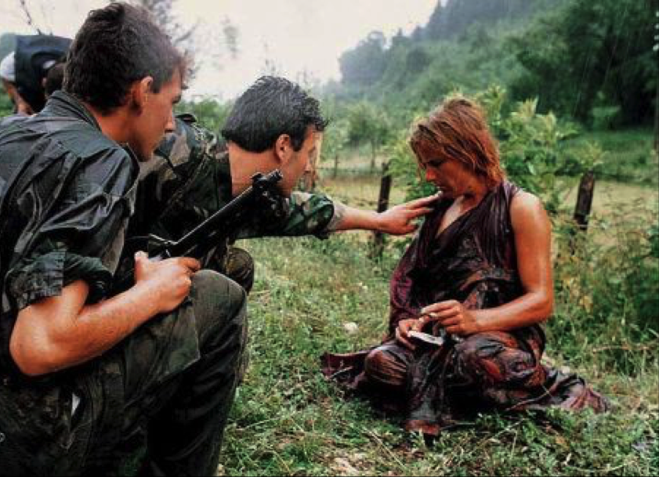
Sexual Assault in Conflict Zones and Prisons
Systematic sexual assault of women, men, and children of both sexes by soldiers:
  By civilians in civil war.
Includes:
  Humiliation
  Forced prostitution
  Forced pregnancy
  Sexual mutilation

Slide 17
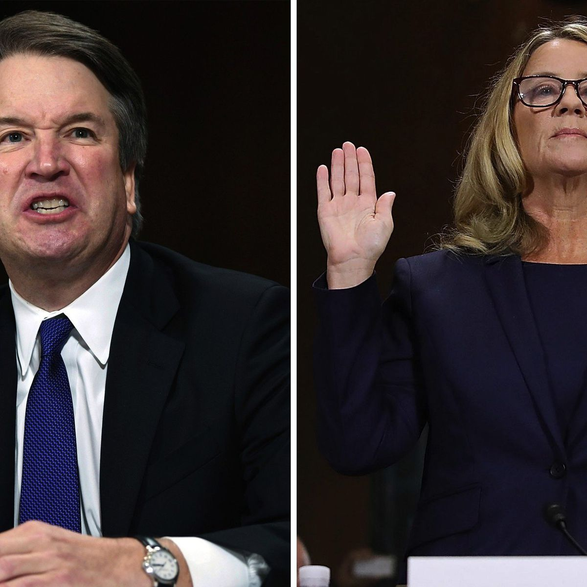
Avoiding and Responding to Sexual Assaults
Addressing gendered stereotypes might reduce sexual aggression.
Confronting sexually hostile attitudes that promote sexual aggression.
Pornography and video games with sexually violent content:
  Associated with a desensitization to sexual violence.
  Not correlated with sexual aggression.
Avoiding intoxication with partners who may have impulse control issues or aggression:
  Date rape drugs: sedative agents such as Rohypnol or GHB which affect memory and reduce resistance to sexual pressure.
Self-defense training can be effective in resisting stranger rape.

Slide 18
Post-Rape Effects
Detached state of shock and emotional numbness.
Desire to wash as a person may feel physically dirty or contaminated:
  Decreases the chances of collecting DNA evidence.
Posttraumatic stress disorder (PTSD)
Sexual dysfunction
Increased risk of major depressive episodes (MDE) and alcohol abuse.

Slide 19

Intimate Partner Violence (IPV)
Physical violence in an emotionally and sexually intimate relationship.
Cycle of abuse:
  Tension building phase: poor communication and attempts by the victim to appease the abuser.
  Violent phase: sudden violent outburst.
  Reconciliation phase: abuser promises never to offend again and expresses genuine remorse.
Other patterns of abuse:
  Bidirectional violence
  Abusive partner remains controlling, suspicious, and emotionally manipulative throughout the relationship.
  Limiting the abused partner’s freedom and access to money and resources.
  Threatening physical violence or even death if the abused partner leaves.

Slide 20
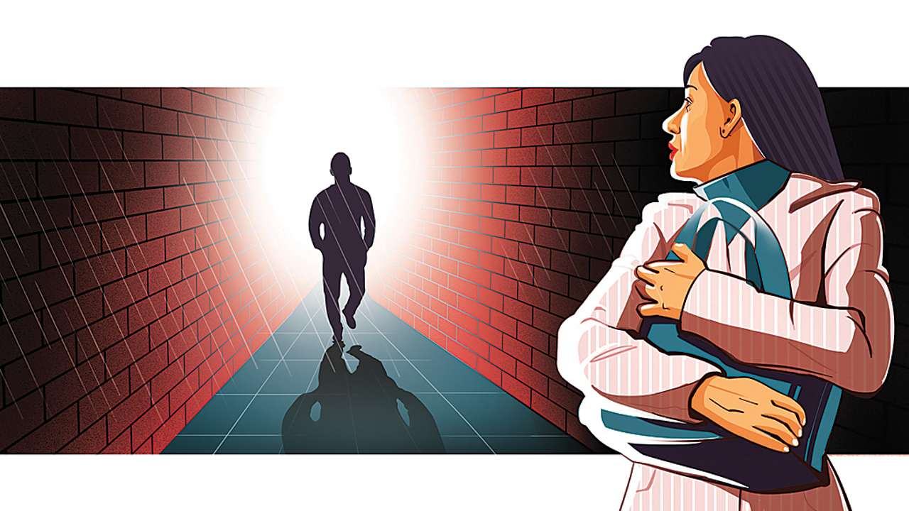
Stalking
Obsessive pursuit of an imagined, desired, current or former romantic partner.
Range of behaviors include:
  Following a person online or in person or waiting for them.
  Incessant contact by phone or electronically.
  Damaging property.
  Physically attacking or threatening to do so.

Slide 21
Types of Stalking
Grudge stalking: done deliberately for the purposes of revenge and intimidation.
Erotomania: delusion that the person being stalked is attracted to the stalker.

Slide 22

Evolutionary and Cultural Aspects of Sexual Violence
Loser male hypothesis: a male unable to have a mate would commit sexual assault.
Increased fecundity hypothesis: selecting for more offspring by increased mating.
Male-male sexual violence is explained in terms of dominance behavior from the evolutionary model. (Common in the military.)
Having a regular sexual partner does not decrease the likelihood of committing sexual assault.
Rates of sexual violence differ widely between countries.
Women and girls are victims of sexual violence more than males in all countries.
Levels of victimization vary widely within societies that face similar challenges.

Slide 23
Feminist Perspective on Sexual Violence
Rape is primarily not a sexual phenomenon but a crime of violence and aggression related to sex roles:
  Many males who perpetrate sexual assault have difficulty achieving arousal or orgasm.
  Males who are highly sexually stimulated by sexual assault represent a very small percentage.
  Sexual aggression occurs against individuals who are too young to be of reproductive age or are the same sex.

Slide 24

Punishment and Treatment of Sexual Offenders
Criminal sentences range from probation to a lifetime in prison:
  Are cumulative and without any limits.
Mandatory treatment programs include:
  Social skills training
  Addressing underlying psychosocial issues
  Identifying behavioral triggers and cues
  Eliminating cognitive distortions
Reduction of sexual interest through chemical castration:
  Critique:
    One cannot be forced to undergo a medical treatment without consent.
    In the U.S., the Constitution limits cruel and unusual punishments including forced medical procedures.
Physical castration to remove the testes:
  Requested by some individual sexual offenders.

Slide 25
Post-Release Restrictions
Circles of Support and Accountability:
  Encourage responsibility for the offender’s behavior.
  Focus on support after release from prison to ensure that re-offenses do not occur.
Megan’s Law: a federal sex offender tracking system that applies in all states:
  Registration in public sex offender registries.
  Mandatory community notifications that an offender is living nearby.
  Residency restrictions.

Slide 26
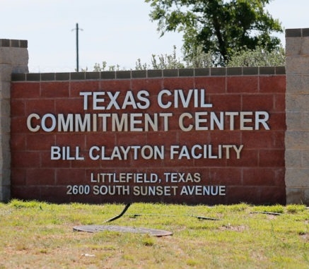
Civil Commitment of Sexually Violent Predators
Anyone with a mental disorder who is danger to self or others can be committed under civil legal proceedings.
Sexually violent predator/person law: applied to those who are at a high risk of re-offense:
  Compare a person’s profile to how others with such a profile typically behave after release.

Slide 27
IPV Treatment Program
Cognitive behavioral model (CBT): focuses on social skills training and anger management that includes:
  Taking responsibility for one’s actions.
  Learning cognitive and behavioral techniques to diffuse one’s anger.
  Cognitive reframing.
  Identifying behavioral triggers.
Duluth Model: uses the Power and Control Wheel and focuses on:
  Gender relations
  Male privilege
  Patriarchal assumptions
  Specific behaviors

Slide 28
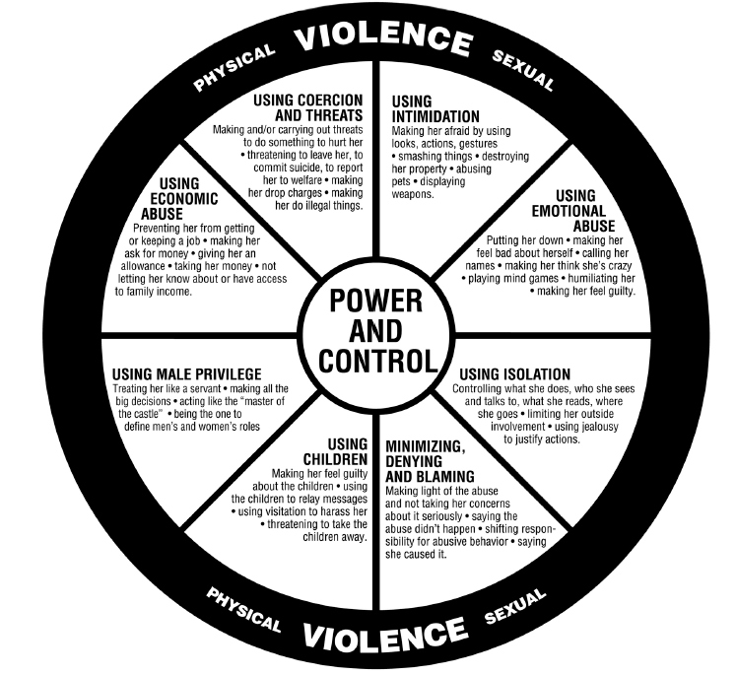
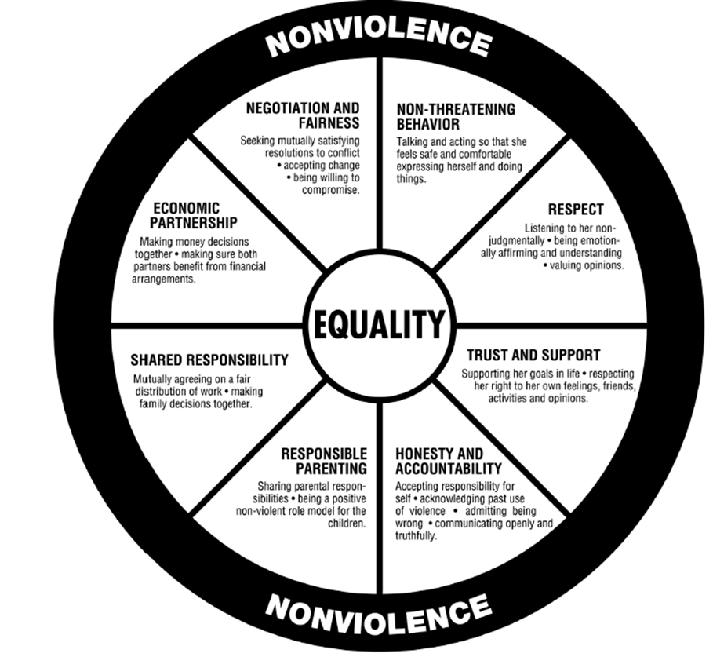
Power and Control Wheel -- Equality Wheel

Slide 29
Consent
Affirmative consent is necessary for any type of sexual behavior.
  In the absence of consent, sexual behavior is a sexual assault, including if a person is unable to give consent due to being high or intoxicated.
Stealthing is a type of sexual assault where a male partner, who is believed to be using a condom, deliberately removes the condom and does not tell his partner as he continues to penetrate the receptive partner (regardless of gender) in unprotected sex.
  It may not always be considered a sexual assault.

Slide 30
Title IX
Estimates of sexual assault on college campuses vary widely, in part due to significant differences in the operationalization of assault.
In order to protect students from sexual assault, the Title IX law is used to require investigations of sexual harassment and gender-based discrimination on college campuses.
  The “burden of proof” required for a decision has been lowered in recent years.

Slide 31
#MeToo and TIME’S UP
The TIME’S UP and #MeToo movements are about helping to reduce all types of sexual aggression, harassment and assault.
To date, hundreds of powerful people, mostly heterosexual men, have had their careers derailed, and a few are under investigation for criminal sexual assault.
But systemic change has yet to occur.
Even for the powerful men, relatively few have actually faced criminal penalties yet, and most have preserved their wealth.

Slide 32
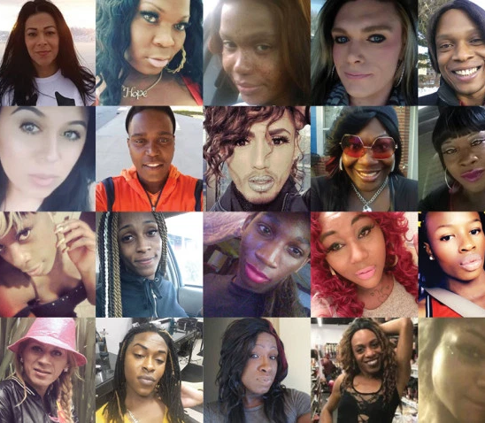
Honor Killings, Acid Attacks, and Hate Crimes
Honor killings: gender violence which targets women for a perceived violation of family honor:
  Murder is perpetrated by a member of family.
  Primarily occur in developing economies.
Forced marriage: adolescent women forced into marriage on threat of violence.
Acid attacks: throwing acid on women not behaving in a manner deemed appropriate.
  Highest in predominantly Islamic regions of developing economies.
  Not common in more industrialized societies.
Hate crimes: assaults and murder targeting lesbians, gay, bisexual, or transgender individuals.
  Perpetrated on the basis of perceived gender role non-conformity.
  Include bullying and victimization.

Slide 33
Other Types of Gender Violence
Female infanticide
Elder abuse
Lack of access to family planning and reproductive healthcare
Female genital mutilation
Selectively nourishing boys over girls
Educating girls less than boys

Slide 34
Non-Violent Violations: Other Sex Crimes
Relate to sexual coercion and aggression of non-consenting paraphilia against humans.
Fall under the sex offender laws.
Involve a type of violence in form of:
  Invasion of privacy
  Lack of consent
  Potential for emotional pain and suffering
Do not involve physical violence or contact.
Frotteuristic disorder: rubbing against a person for sexual pleasure with consent.
Voyeuristic disorder: watching someone without consent for sexual pleasure.

Slide 35

Non-Violent Violations: Other Sex Crimes
Exhibitionistic disorder: flashing or exposing one’s genitalia to another without consent.
Necrophilia: sex with dead bodies.
Telephone scatologia: obscene telephone calls.
Zoophilic disorder: sex with animals.
Having consenting sex with another person in a public place is typically against the law.
Treatment:
  Cognitive behavioral therapy:
    Social skills training
    Identifying triggers and behavioral cues that lead up to offending
    Implementing strategies to prevent relapse
    Working on cognitive distortions that may justify or facilitate engaging in the behavior

Slide 36

Sexual Harassment in the Workplace and School
Sexual harassment: wide range of unwelcome behaviors that are sexual in nature:
  Demands for sex in exchange for employment.
  Unwanted sexual attention.
  Jokes that are offensive and sexual in nature.
Individual harassment: direct harassment.
Environmental harassment: involves a workplace or other environment which is hostile in terms of:
  Sexual comments
  Offensive jokes
  Tolerance for sexual innuendo or other sexualized or gender-based hostility

Slide 37

Categories of Sexual Harassment
Considered civil offense when it is non-violent and does not involve verbal aggression:
  Except in the military
Can occur between any people of differing levels of power and resources:
  Civil sanctions applicable when there is some type of professional relationship.

Slide 38

Quid Pro Quo Harassment
Sex is necessary for obtaining or retaining some type of resource that the harasser controls over the victim.
Can occur between any two people of differing levels.
Military prohibits fraternization between those of different ranks.
Universities prohibit expression of:
  Interest in relationships
  Sexual glances
  Jokes between faculty and students

Slide 39

Hostile Environment Harassment
Creating or allowing an environment which is offensive on the basis of gender or sexual orientation:
  Includes offensive comments and jokes.
Individual employee or an entire group may be targeted.
Sexual desire is not a necessary component for sexual harassment.

Slide 40
Prevention, Effects, and Coping with Harassment
Corporations and employers have standards and reporting mechanisms for harassment.
Employment Opportunity Commission (EEOC)
  Investigates claims of harassment and compliance as well as compliance with anti-discrimination laws.
  Provides a mechanism outside of the civil courts for addressing problems.
Response to harassment:
  Clearly communicate that the behavior or situation is unwanted.
  Document the communication.
  Find out the specific policy and reporting mechanisms for the workplace or organization.

Slide 41

Gender Harassment
Unwanted sexual attention combined with sexual harassment:
  Telling sexually suggestive stories without differentiating whether they are welcome or unwelcome.
Concerns about limits on free speech from policies designed to reduce discrimination and harassment.

Slide 42
Dual Relationships
Association or intimate relationship with someone with whom one has a professional relationship:
  Has potential for exploitation due to the inherent power difference.
Sexually intimate relationships with patients are against the ethical codes.

